Slide 1
Contents
Angles measures: degree vs. radians
Period, frequency, angular frequency
General template for a sine wave
Non-sine wave periodical functions
Principles of the spectral analysis
Physical demonstration with LED and PWM signal
Acoustic resonators and filters

Slide 2
Angles measures: degrees vs. radians
L
“Positive rotation” – anti-clockwise, when the contour remans at the left
R - radius
ϕ
L ∼ ϕ × R
ϕ in “radians”
L = ϕ × R
2π ↔ 360⁰ – full revolution
π = 3.1415…. (“pi” number; transcendental )

Slide 3
Period, frequency, angular frequency
ϕ
T (period) = Time of the full revolution (seconds, minutes, etc)
f (frequency) = 1 / T → 1 / 1s = 1 Hz (Hertz)
ω = 2 × π × f (rad/s) − angular frequency
ϕ = ω × t (rad), t – time in seconds

Slide 4
sin(ϕ) and cos(ϕ) as the projection functions
Y
R×sin(ωt)
R
R×sin(ϕ)
ϕ
X
R×cos(ϕ)
R×cos(ωt)
https://en.wikipedia.org/wiki/List_of_trigonometric_identities

Slide 5
General template for a sine wave
T
A

Slide 6
Numerical example: DC offset, amplitude, and frequency of a sinusoid

Slide 7
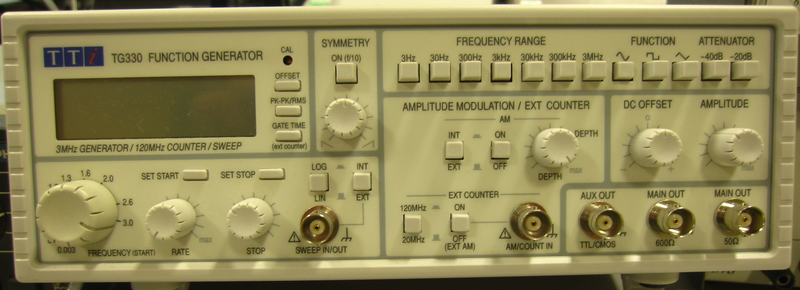
Function generator: different waveforms
Different waveforms:
sinusoidal, square, and triangle
Frequency ranges (maximum frequencies)
and smooth variation within each range
Attenuation: 20×log₁₀(V_{in}/V_{out}) dB
−20 dB = 20×log₁₀(1/10) ⇒ attenuation 1/10
−40 dB = 20×log₁₀(1/100) ⇒ attenuation 1/100
Digital display for all options

Slide 8
Function generator: sin wave and its parameters
Positive or negative
Pk-Pk or RMS

Slide 9
Function generator: triangle waveform and its parameters
T − period
Amplitude
Ground
Pk-Pk
f = 1/T − frequency
Positive or negative
Pk-Pk or RMS

Slide 10
Function generator: square pulse waveform
T − period
Ground
Amplitude
Pk-Pk
T /2
T /2
f = 1/T − frequency
Positive or negative
Pk-Pk or RMS

Slide 11
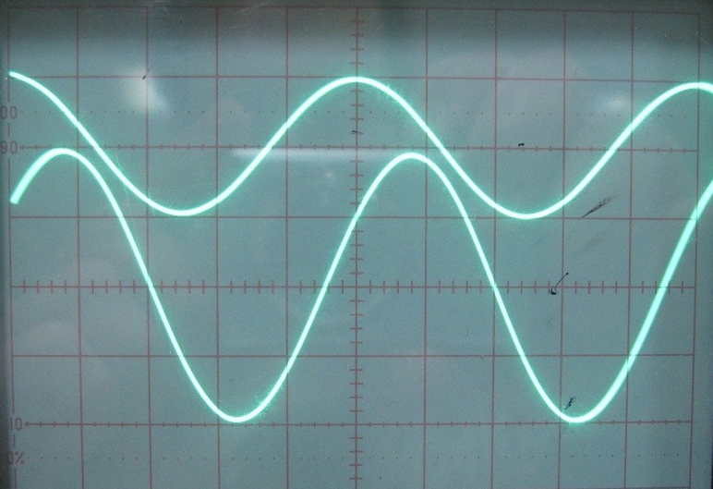
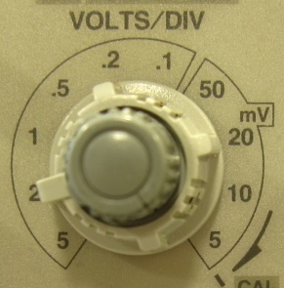
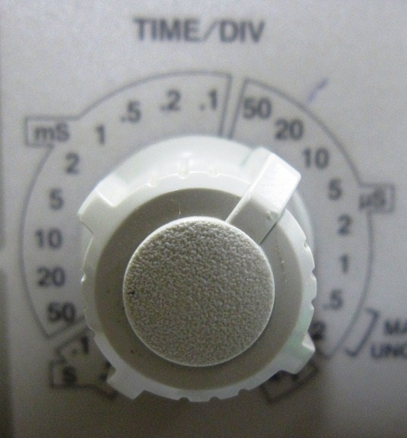
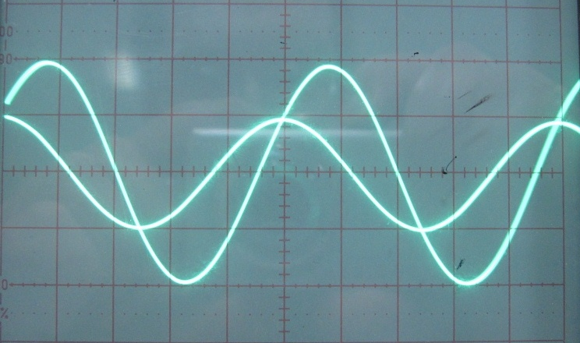
Analysis of waveforms on oscilloscope
1 V/DIV
20 μs/DIV
t₁
DC offset
t₀
Δt
Zero DC offset
t₁
t₀
Δt

Slide 12
Spectrum and the concept of Fourier series
Using a sum of weighted sinusoids with multiple frequencies we could try to describe more complicated waveforms. Such a sum is called Fourier series. The set of multiple frequencies in a Fourier series is called the frequency spectrum. And, each sine or cosine function in the Fourier series is called the harmonic.
Example of the evolution towards a square waveform: one harmonic, sum of two harmonics, sum of three harmonics
ripple

Slide 13
Spectrum of a square pulse waveform
Due to very fast amplitude changes (“jumps”), a square waveform requires a large number of harmonics in the Fourier series (1000 or more) to describe its waveform and avoid a strong ripple effect. The latter cannot be completely suppressed, but for a sufficiently large number of harmonics the ripple oscillations can be reduced to an acceptable level.

Slide 14
Fourier series: symmetrical triangle waveform
Since a triangle waveform is continuous (without “jumps” as in a square waveform), it requires a less number of harmonics in the Fourier series to describe its waveform. For a triangle waveform, the ripple effect is not observed.

Slide 15
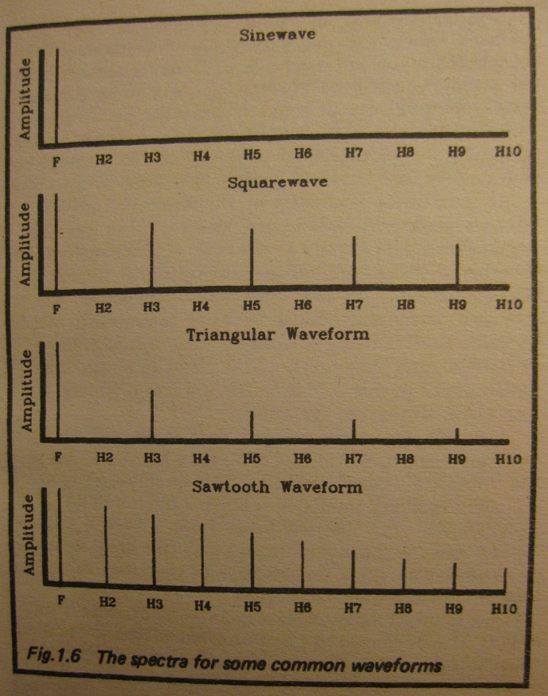
The spectra for some common waveforms
H_{k} = k×f − harmonics; k = 2, 3, 4,…..
f = 1/T – fundamental frequency

Slide 16
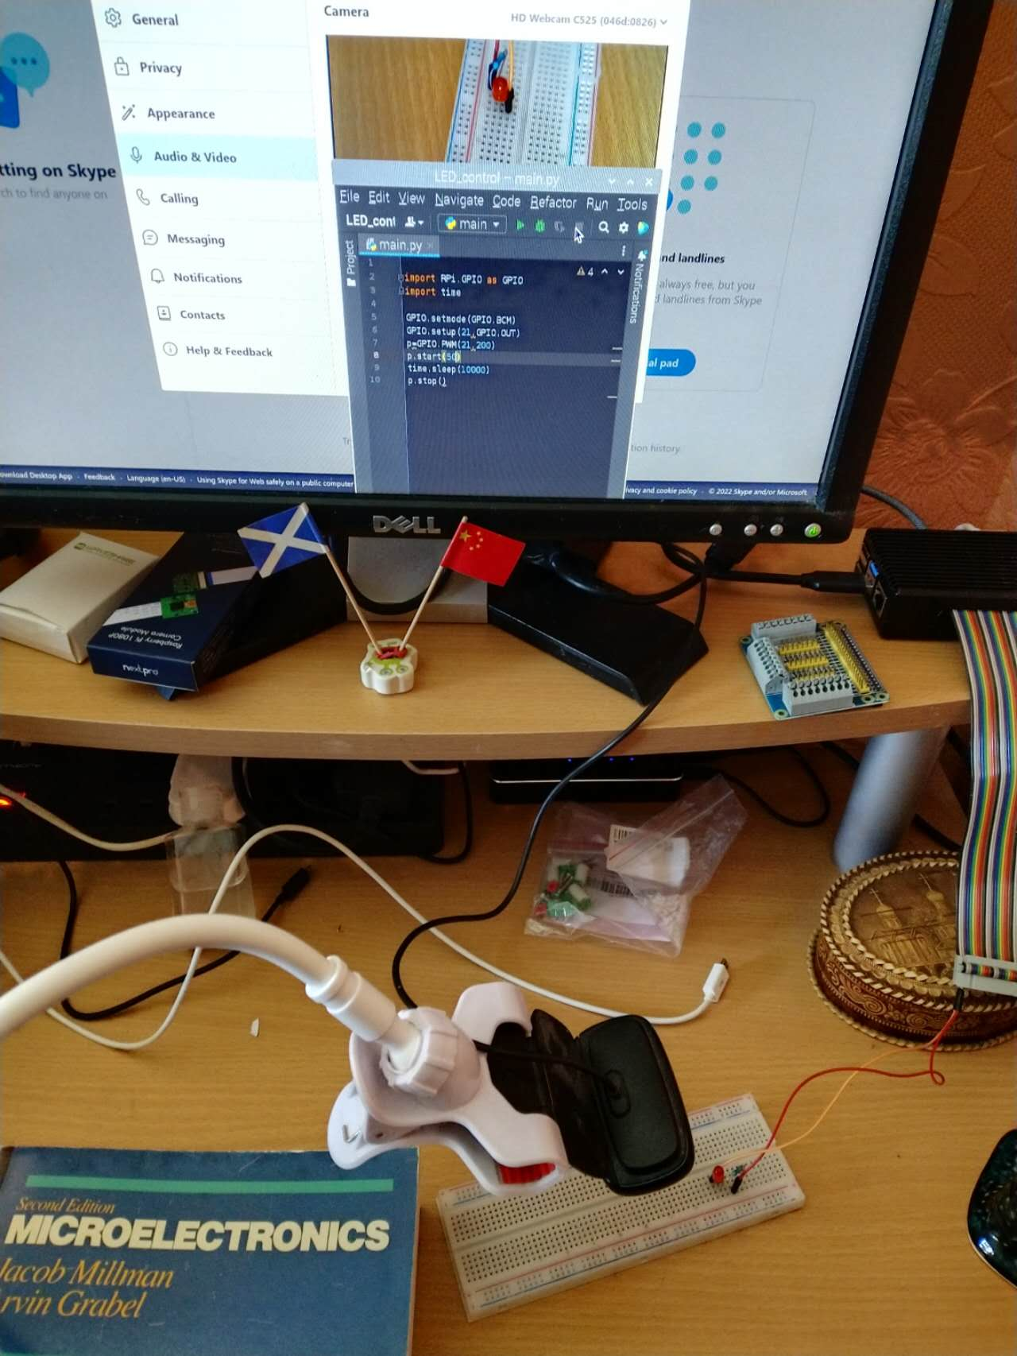
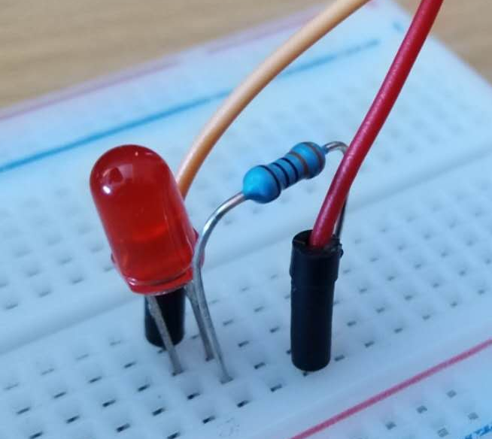
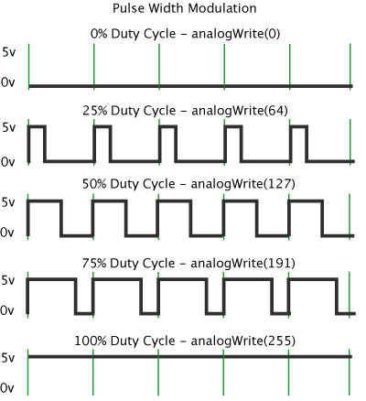
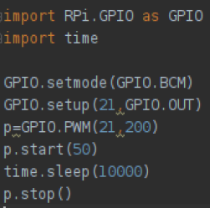
PWM – Pulse Width Modulation
Python code
Raspberry Pi 4B
Webcam

Slide 17
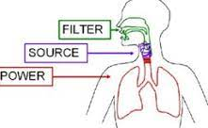
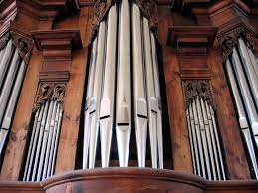
Spectral analysis in music and nature
oral cavity and skull → sound tone
vocal cords → wide spectrum vibrations
lungs → air flow
Each resonator selects only one frequency (or a narrow band) and cuts the rest of the spectrum
Whistles work as the white noise generators (very wide spectrum)

Slide 18
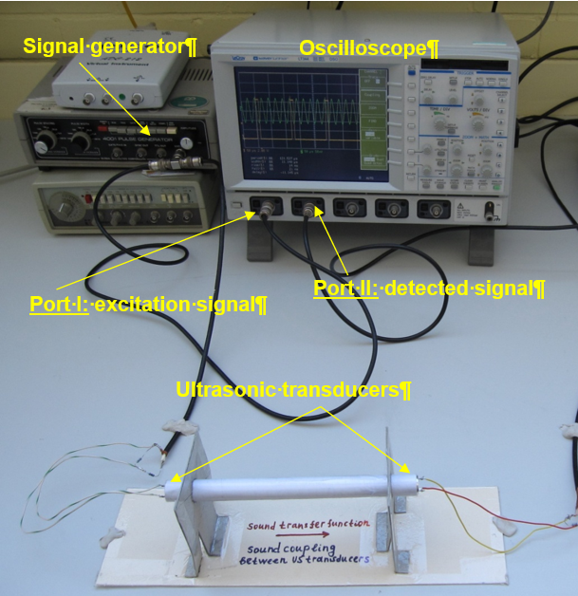
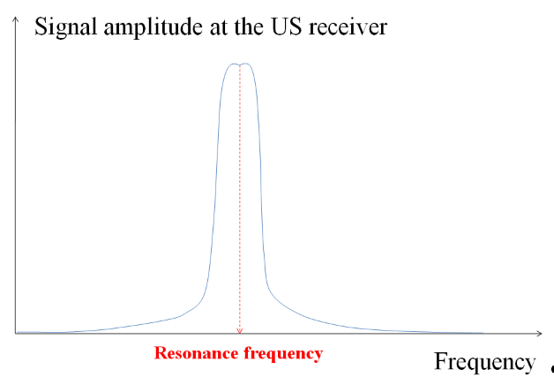
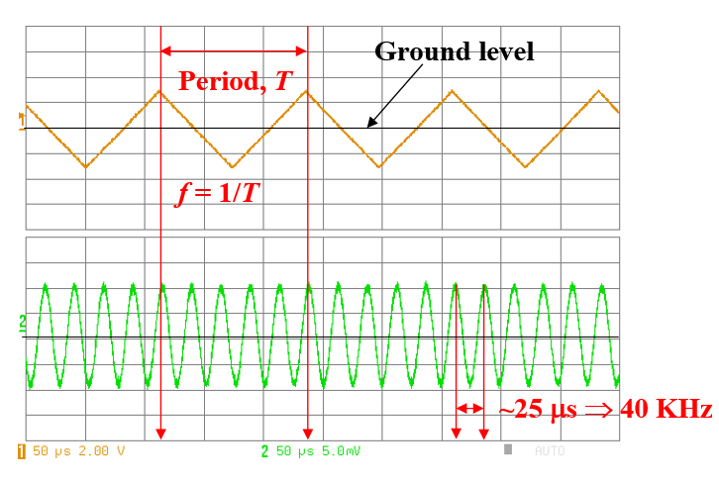
Ultrasonic (US) transducers as narrowband filters
∼40 kHz
Excitation signal
On the oscilloscope screen, we will always see sine waves (and never sawtooth) if the excitation sawtooth signal has the frequency 40 kHz, 13.3 kHz, or 8 kHz. For any other frequencies the detected signal will be negligible. How to explain these effects?
Detected signal

